Slide 1

WELCOME

Slide 2


A Presentation On Geo-BI Data Visualization M.Sc. Agriculture Analytics Presented by, Nidhi Chaudhary(202419004) Priyanka Thakor(202419013) Submitted to, Dr. Kapil Oberoi (Geoinformatics Department) Indian Institute of Remote Sensing Indian Space Research Organization May, 2025

Slide 3
Overview of Project
Step 1
Step 2
Step 3
Step 4
Step 5
Step 6
Introduction
Objectives
Study Area and Datasets Used
Methodology
Result and Discussion
Conclusions
overview of project
Objectives of project
Details of Datasets and Location used in this project
Description of the methods and formulae used
Explanations for the obtained results
Output of Project

Slide 4
Introduction
This project introduces Varhedarna village's method of cropping and harvesting pattern, irrigation and farmer’s supplementary livelihood. which allows one to forecast the harvesting date based on the crop's life cycle. Following the date prediction, the dates are broken down into months, making it simple to determine which crops should be harvested on the approaching dates. Additionally, statistical analysis of the gathered data is provided on an open-access online platform. The main goal of this project is to visualize agricultural data using programming and other approaches and apply it to the actual world, which will help farmers and crop supply and crop visualization.

Slide 5
Objectives
To digitize the village of Varhedarna and split Survey No. plots into smaller polygons based on farm size using Google satellite image.
To perform spatial and temporal analysis of agricultural data using geo-tagged datasets.
To develop intuitive dashboards using Tableau and Power BI that visualize patterns across time and geography .
To forecast harvesting timelines by examining the relationships between crop types, sowing periods, and climatic or regional influences.

Slide 6
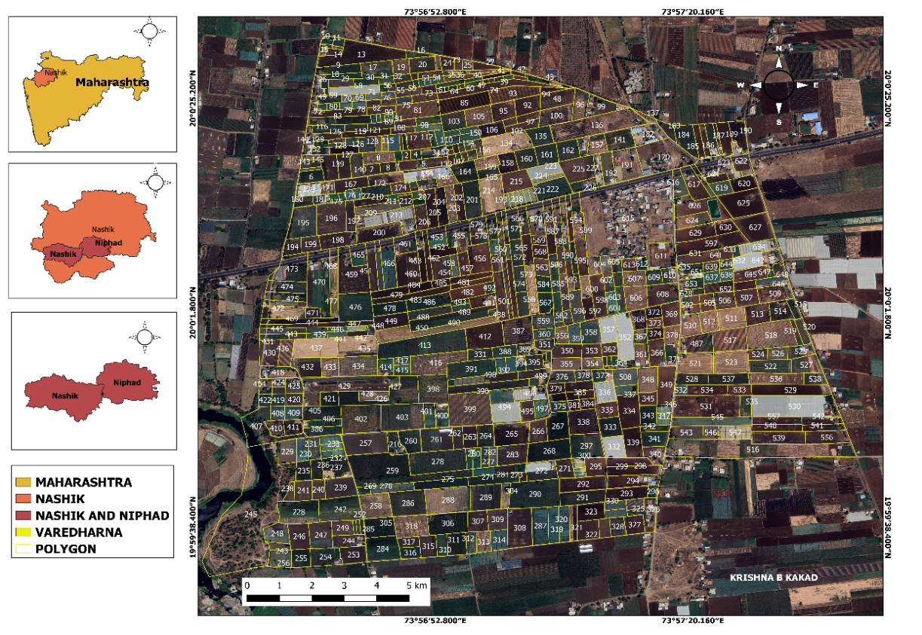
Study Area
The village of Varhedarna is situated in Maharashtra, India's Niphad tehsil within the Nashik district. It is located 20 kilometers from the district headquarters in Nashik and 20 km from the sub-district headquarters in Niphad (the tehsildar office).
Varhedarna is the gram panchayat of Varhedarna village, according to 2009 statistics. The community occupies 244 hectares of land in total.
There are 1,545 people living in Varhe Darna overall, of whom 815 are men and 730 are women.
Varhedarna Village has a 66.60% literacy rate, with 61.51% of women and 71.17% of men literate. Varhedarna village has roughly 326 dwellings in total.
Figure :Varhedarna Village Study Area

Slide 7
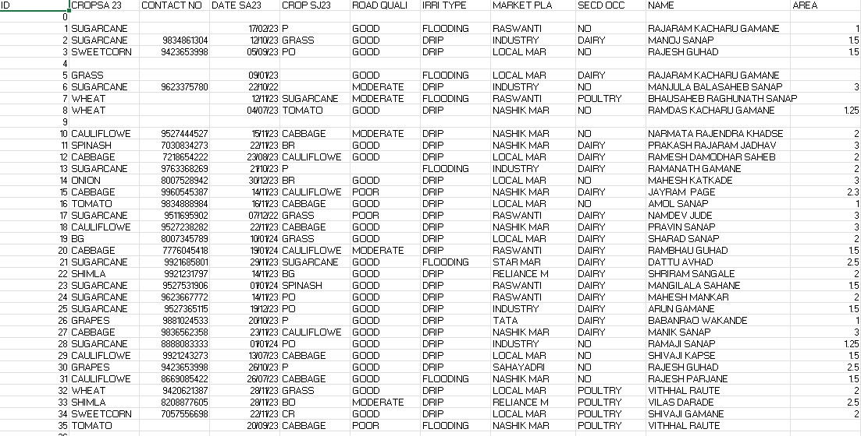
Geotagged data collected by field survey :

Slide 8
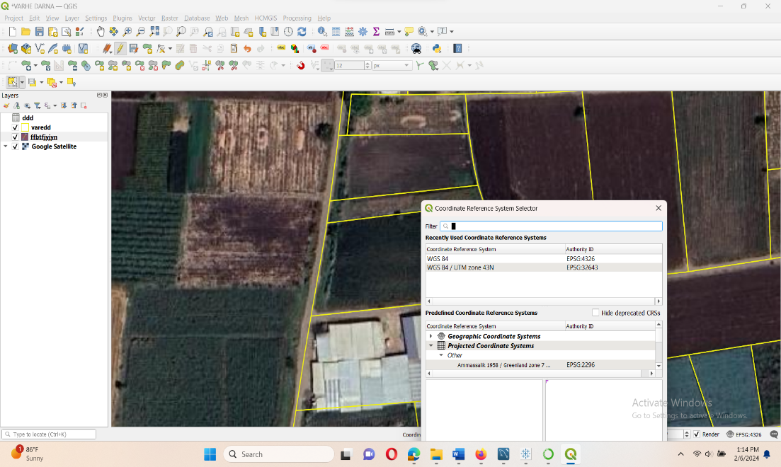
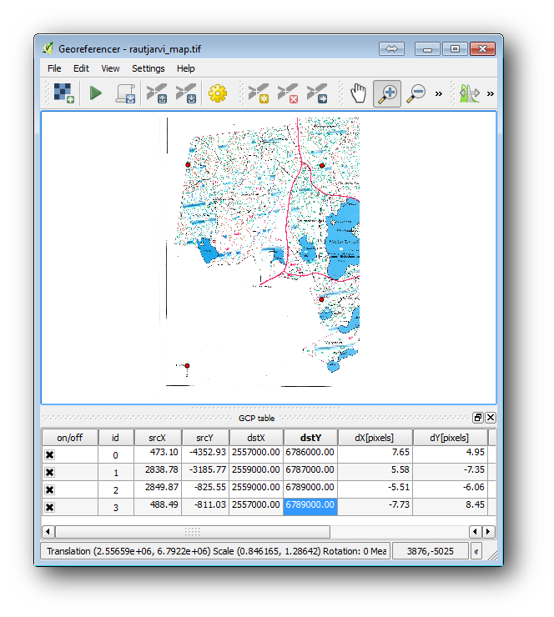
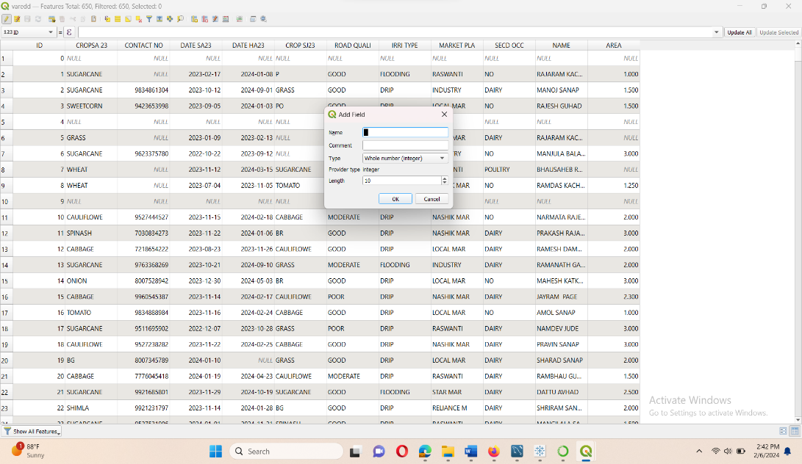
Methodology:
Digitization of Varhedarna village
3
1
Creating Fields in Attribute Table
Georeferencing of Cadasterl map
2

Slide 9
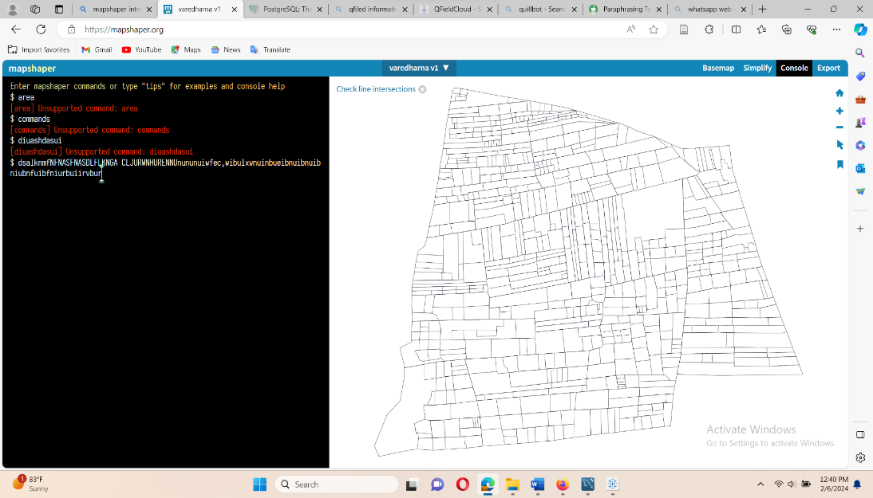
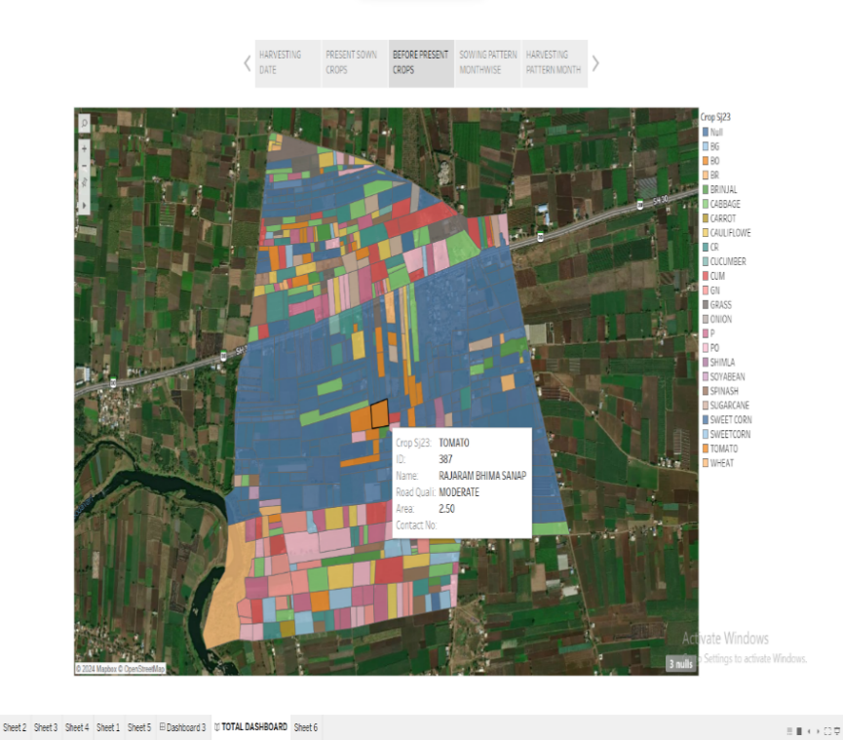
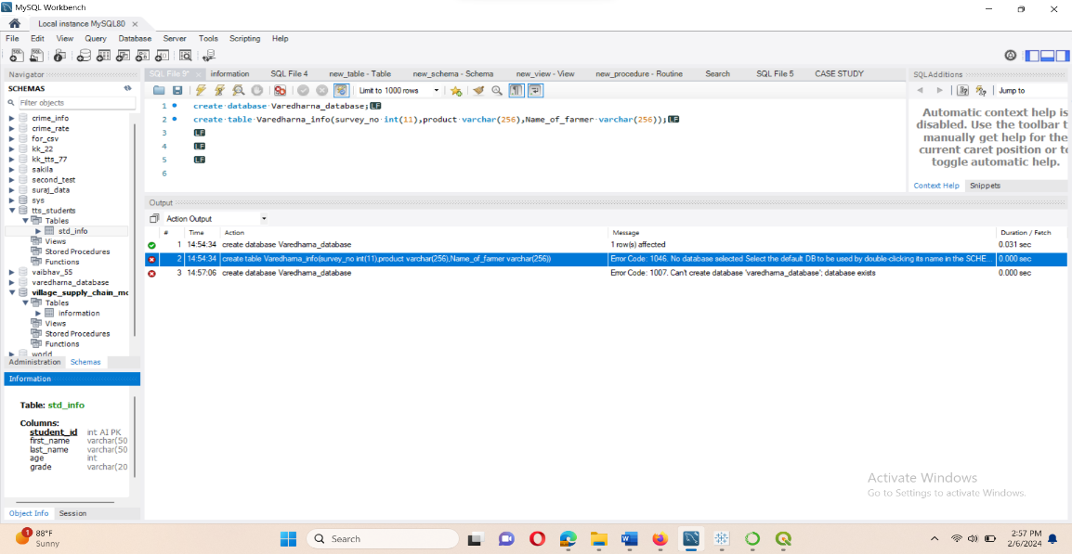
Tableau Data Visualization
Mapshaper
5
Creating a Database
4
6

Slide 10
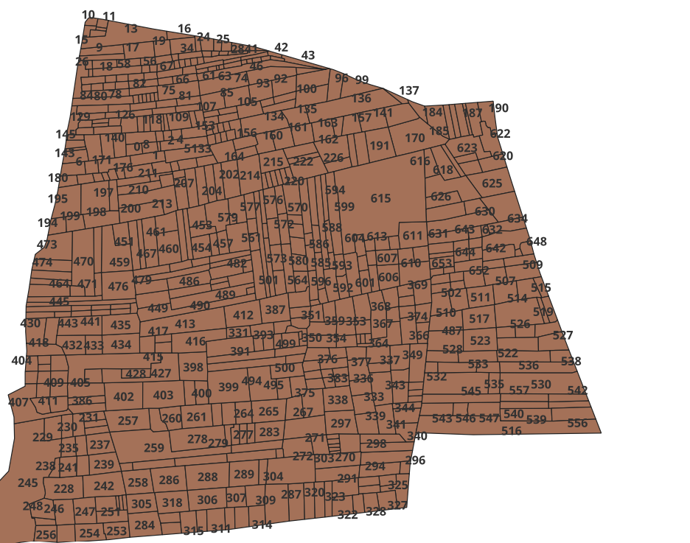
Digitization
The process of converting raster GIS data into vector data by manually tracing the desired features.
QGIS Provide many tools for digitization.
Flowchart :
Open QGIS and Add Raster layer
↓
Create a vector layer and Set scale and Lock it
(Point, Line, Polygon)
↓
On toggle editing and Draw features
↓
Save editing and off toggle editing
Figure : Varedharna Village Digitization

Slide 11
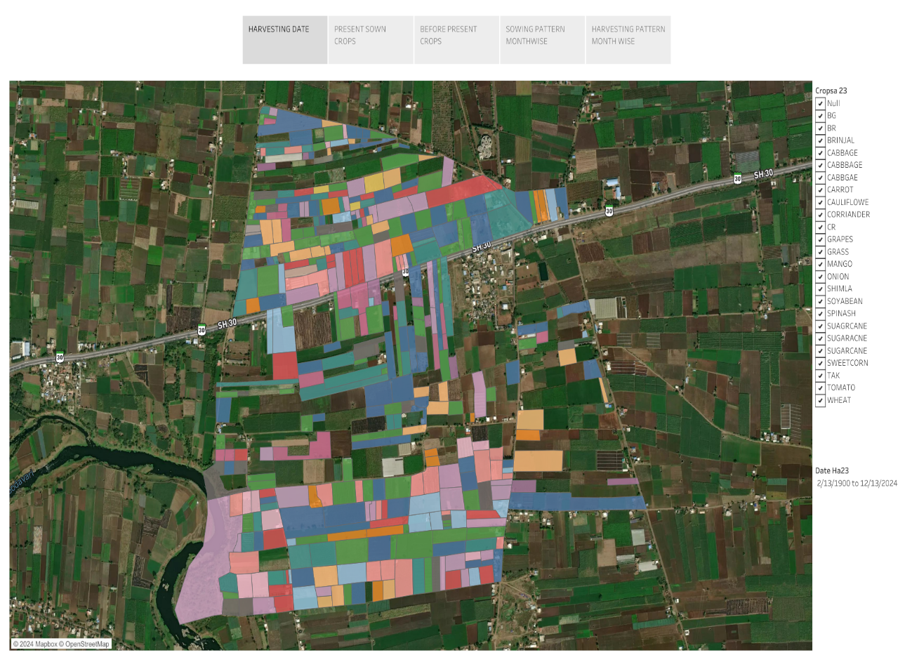
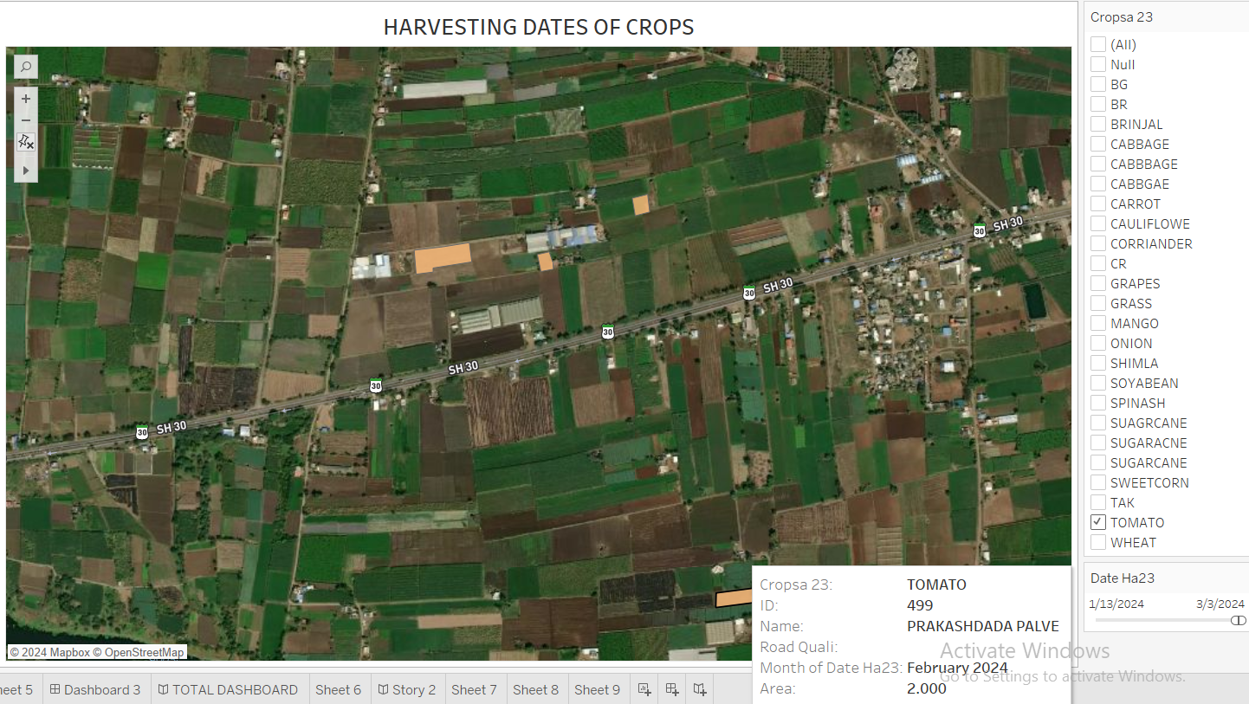
Harvesting Date Prediction Window for Varhedarna Village:
ID | 331
Name of Farmer | Nandakishor Gopal Sanap
Area | 3
Contact No. | 9921492238
Crop to be Harvesting | Sugarcane
Road Quality | Moderate

Slide 12
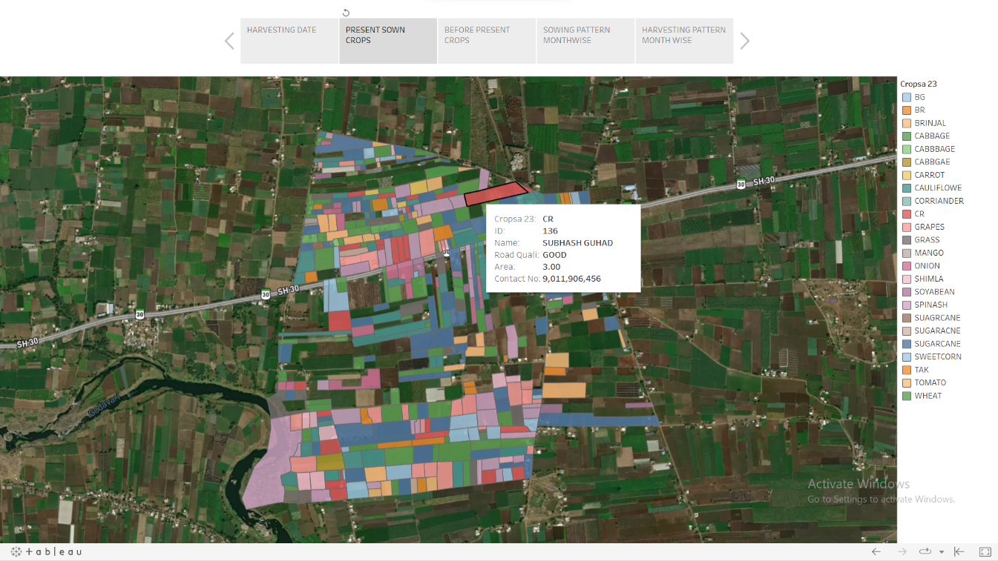
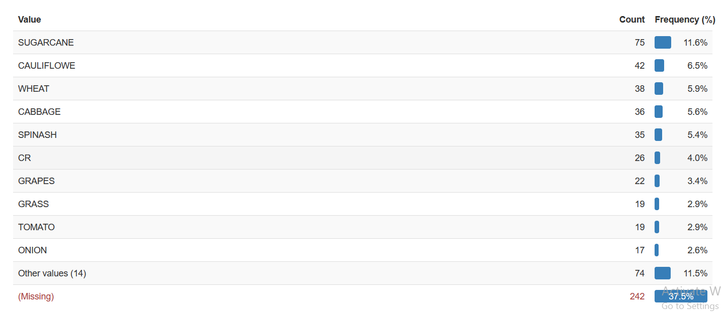
Present Crop Sown Varhedarna Village:

Slide 13
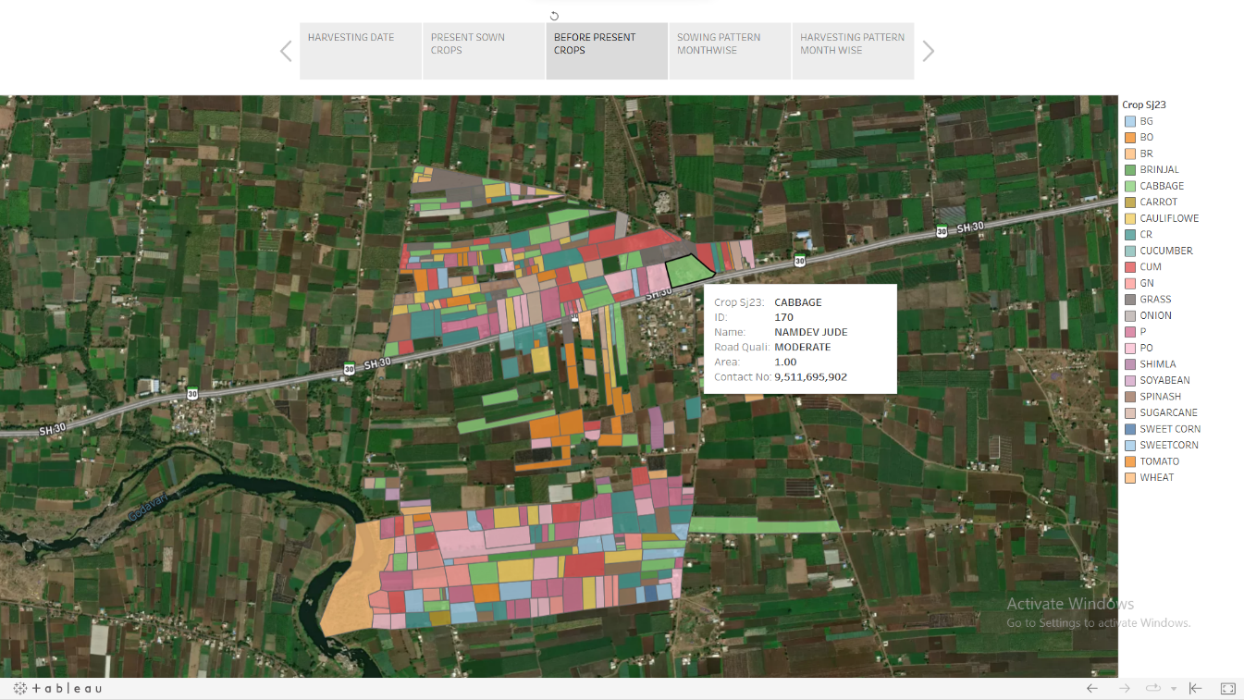
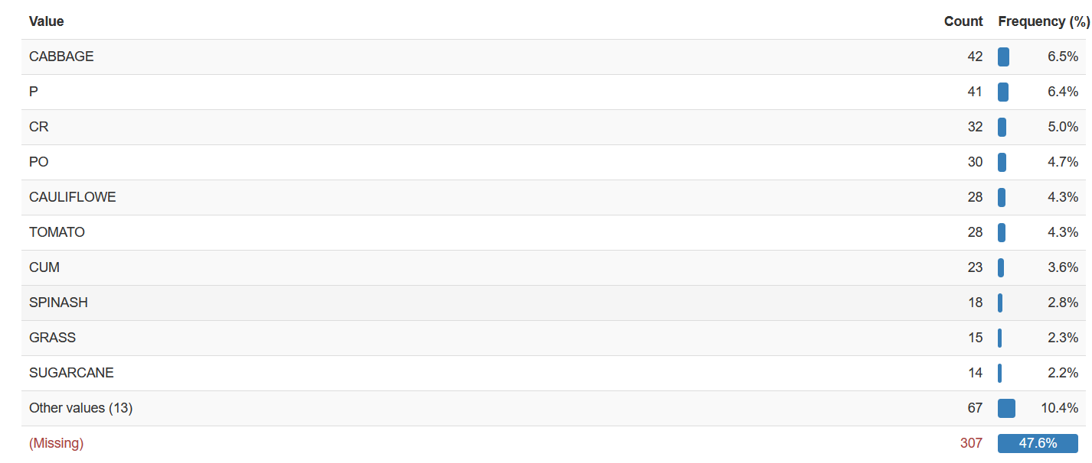
Past Sown Crop Varhedarna Village:

Slide 14
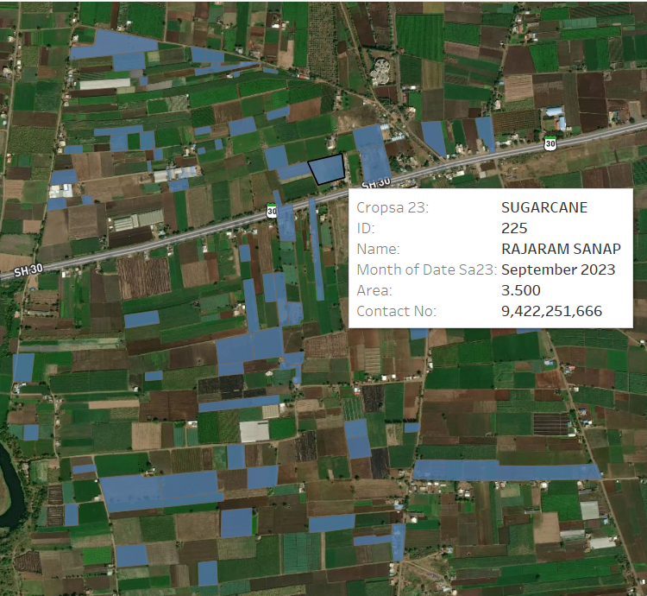
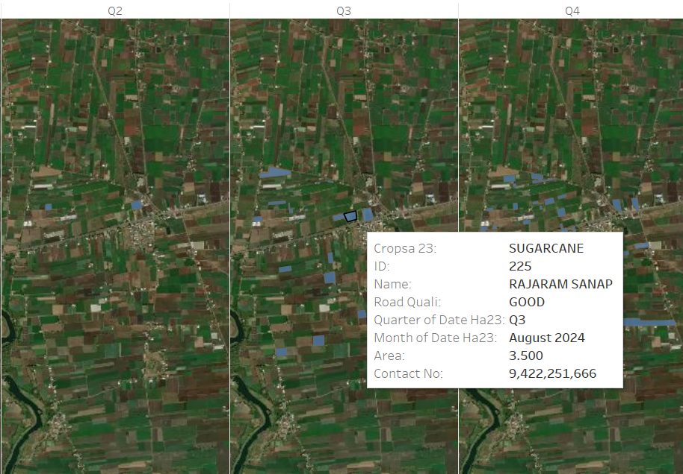
Sugarcane Cropping and Harvesting Pattern Varhedarna Village:

Slide 15
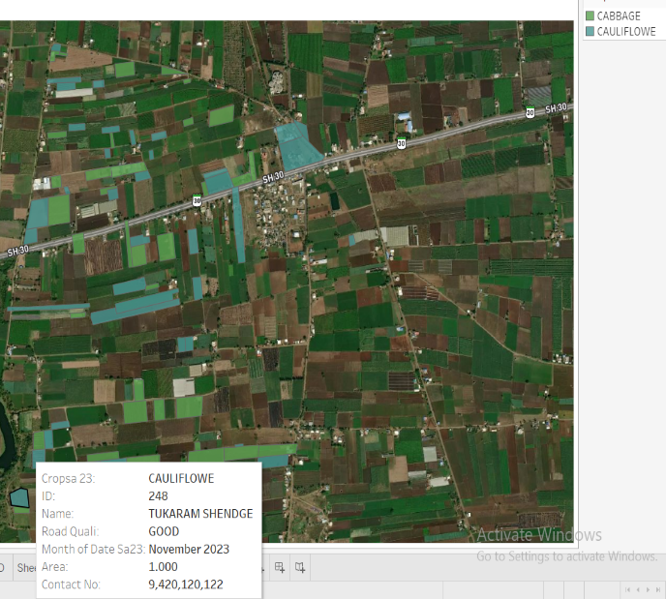
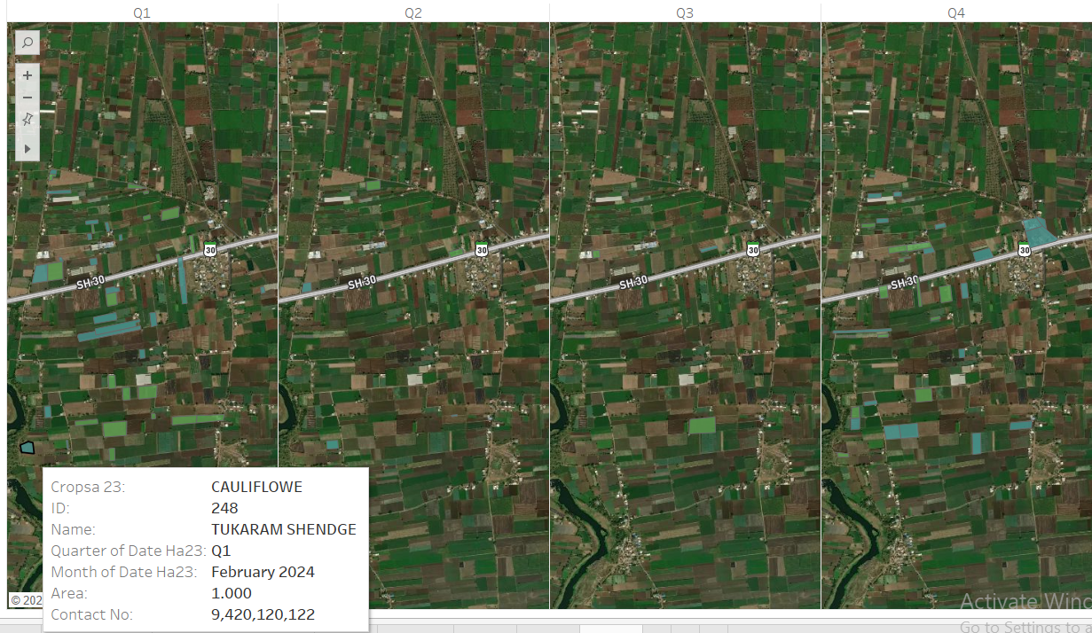
Cabbage and Cauliflower Cropping and Harvesting Pattern Varhedarna Village:

Slide 16
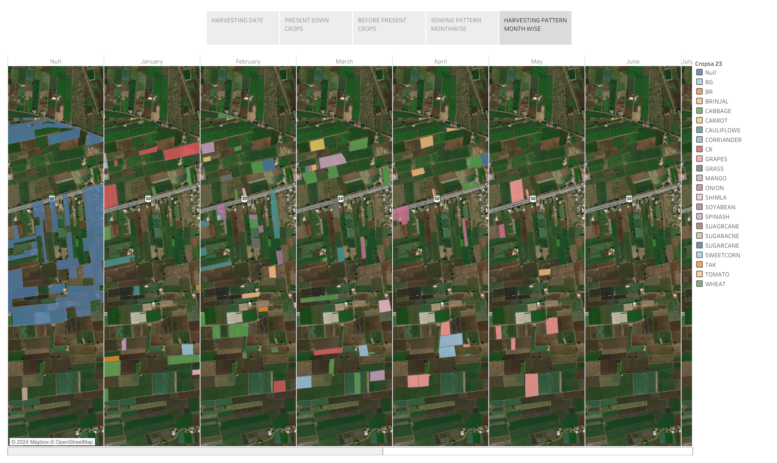
Harvesting Pattern Month wise for Varhedarna Village:

Slide 17
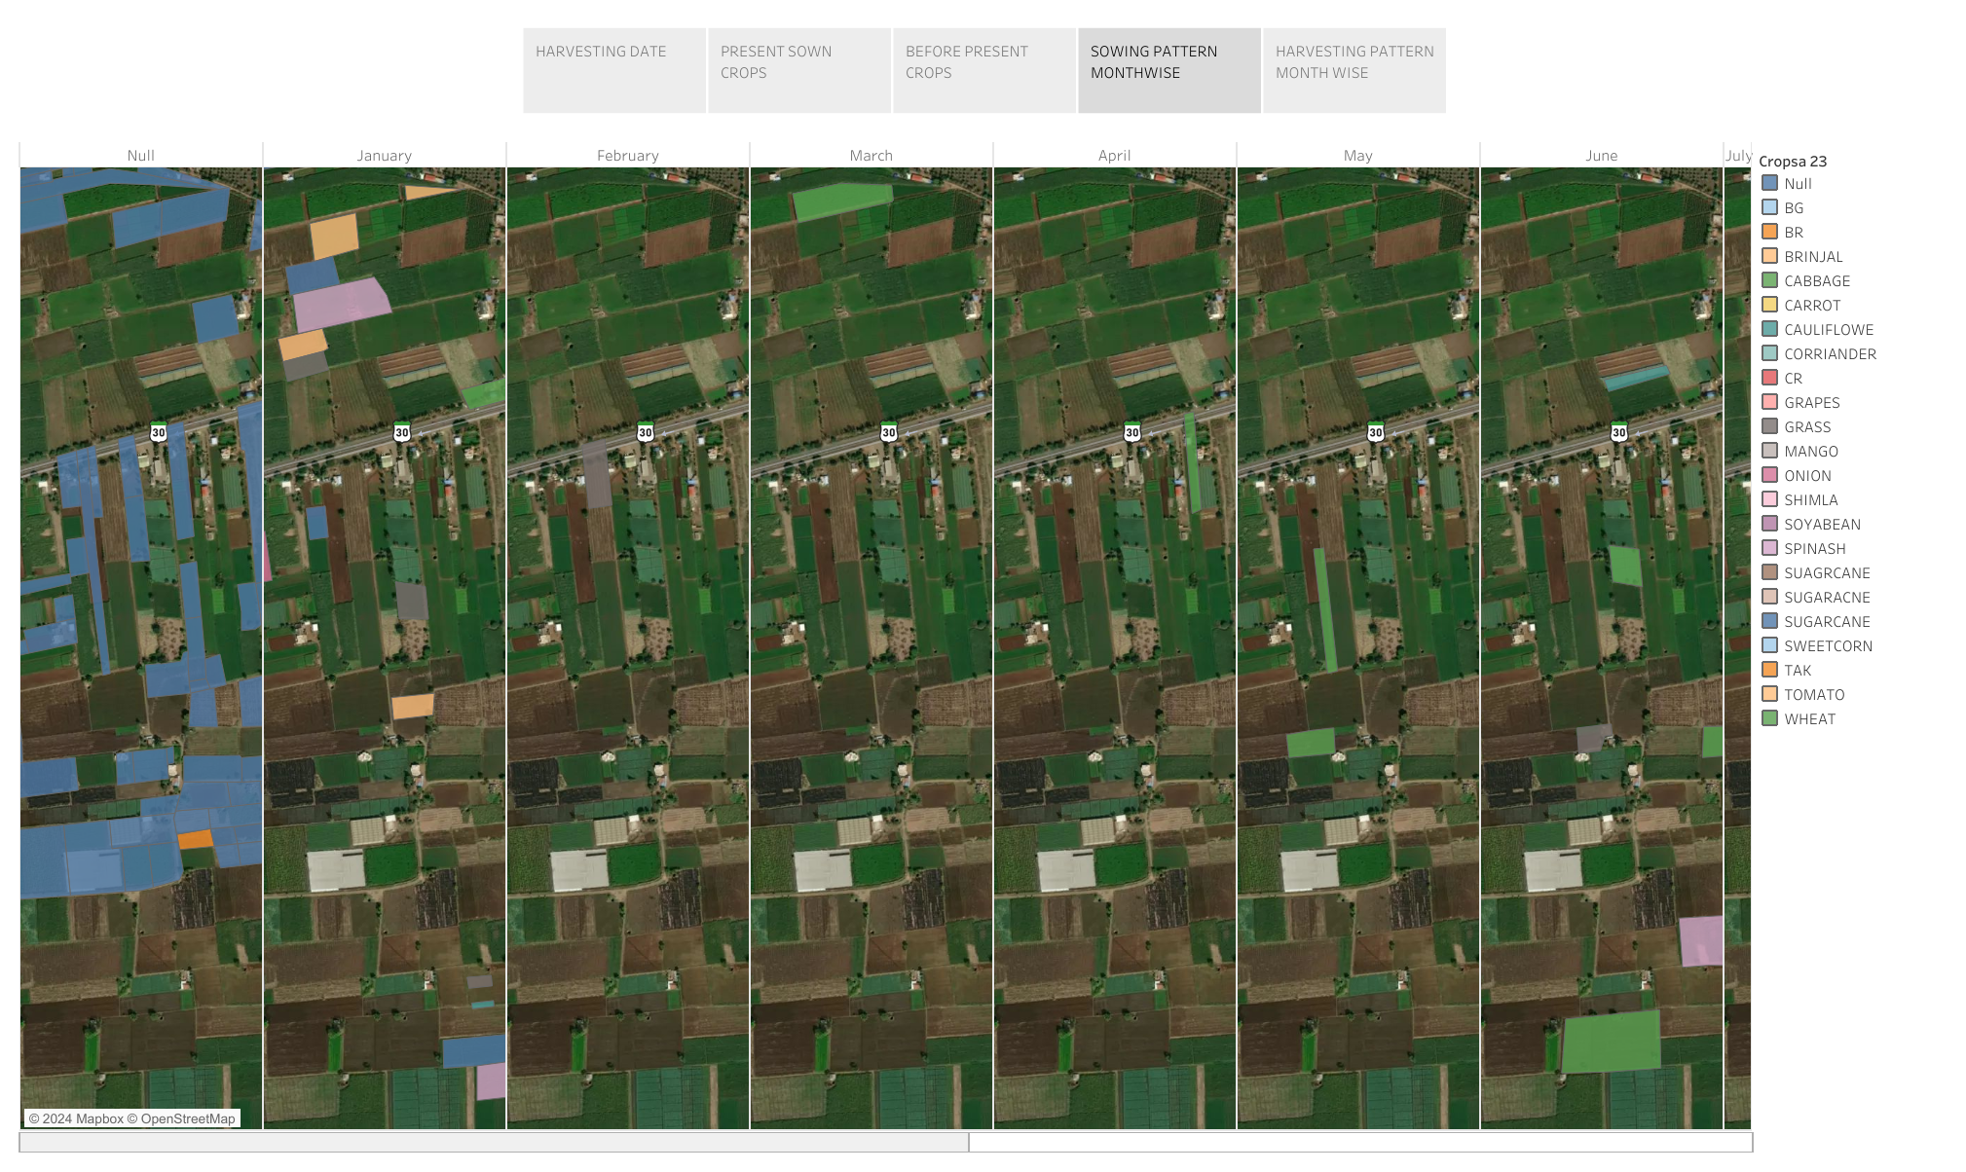
Sowing Pattern Month wise for Varhedarna Village:

Slide 18
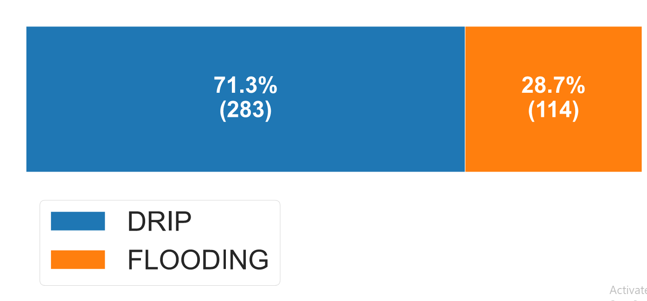
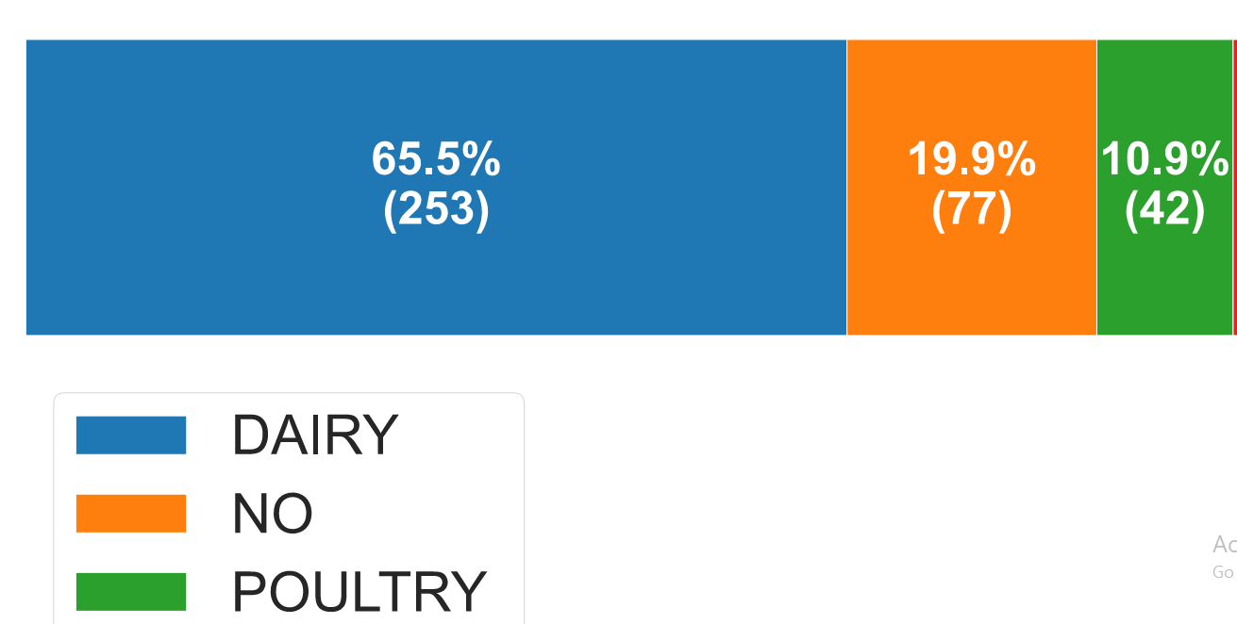
1.
Figure: Irrigation System Distribution in Varhedarna Village:
2.
Figure: Secondary Occupation Distribution in Varhedarna Village:

Slide 19
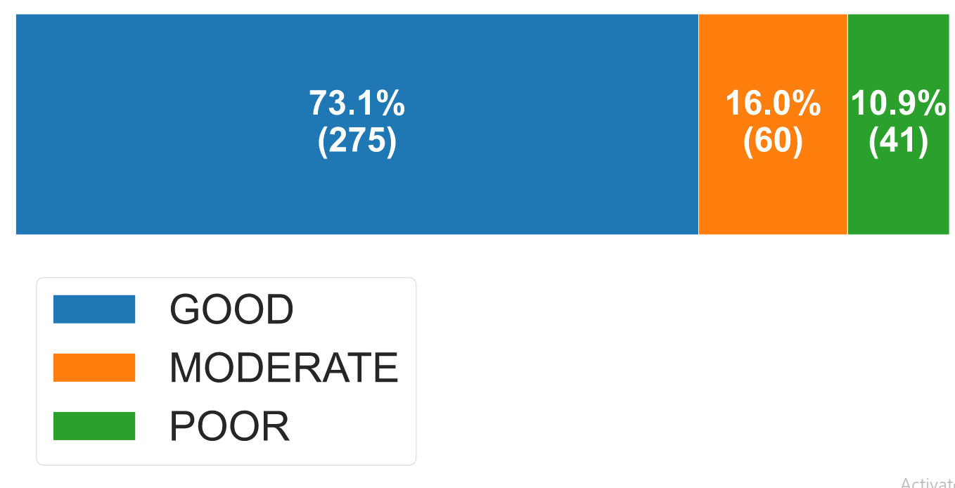
3.
Figure: Categorization of Road Quality in Varhedarna Village
4.
Geo-Portal Visualization:
https://public.tableau.com/app/profile/krishna.kakad/viz/BIG_DATAANLYTICS/TOTALDASHBOARD

Slide 20
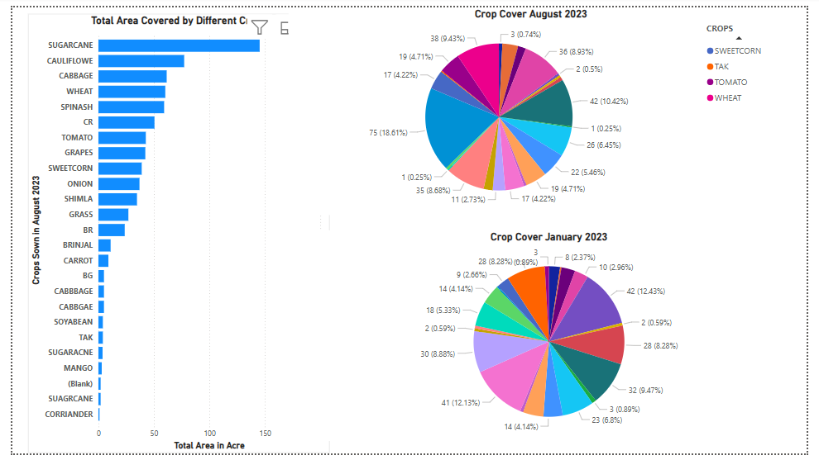
Power BI Visualization:
In August 2023, a horizontal bar chart shows that SUGARCANE covered the largest land area, followed by CAULIFLOWER, CABBAGE, WHEAT, and SPINACH, though data quality issues like repeated entries, abbreviations, and blank values were noted. The August crop distribution pie chart reveals that the largest crop occupied 18.61% of the total area, with other major crops like WHEAT, TOMATO, SWEETCORN, and TAK contributing between 9–10%. In comparison, the January 2023 pie chart shows a more balanced distribution, with several crops each covering 8–12% of the area, indicating greater crop diversity during the winter season.,

Slide 21
Conclusions:
The land cover as it appears on plots or polygons Sugarcane has been planted in more plots than other crops; data collection ,indicate that it makes up around 11.6% of the total area. The particular land cover percentages for each crop are as follows: 6.5%, 5.9%,5.6%,5.4%,4.0%,3.4%,2.9%,2.9%, and 2.6% for onions, tomatoes, grapes, cauliflower, wheat, cabbage, spinach, and onions, respectively.
From previous cropped crops on the polygons Compared to other crops, cabbage had been planted in more plots; data gathering numbers show that it takes up around 6.5% of the total area. Here are some details broken down by crop for the land cover: Cauliflower, wheat, sugarcane spinach, cucumber, potatoes, coriander, and fallow land had respective yields of 6.4%, 5.0%,4.7%,4.3%,4.3%,3.6%,2.8%,2.3%, and 2.2%.
Approximately 71.3% of farmers have installed drip irrigation systems, whereas 28.7% of people water their property using the traditional method of flooding in Varhedarna Village.

Slide 22
According to the data displayed, dairy shares around 65.5% of all other related occupations. The percentages for poultry and non-allied occupations are 19.9% and 10.9%, respectively.
As per the presented statistics, the category of good roads accounts for approximately 71.3% of all other connected categories. The proportions of other people falling into the poor and intermediate categories are 10.9% and 16.0%, respectively. As a result, Varhedarna Village enjoys excellent access to the roads.

Slide 23

THANK YOU!

